Slide 1

The Drive By Project
Software Manager: Dirk Thieme
Hardware Manager: Erik Manis
Project Controller: Mohammed Ansari

Slide 2
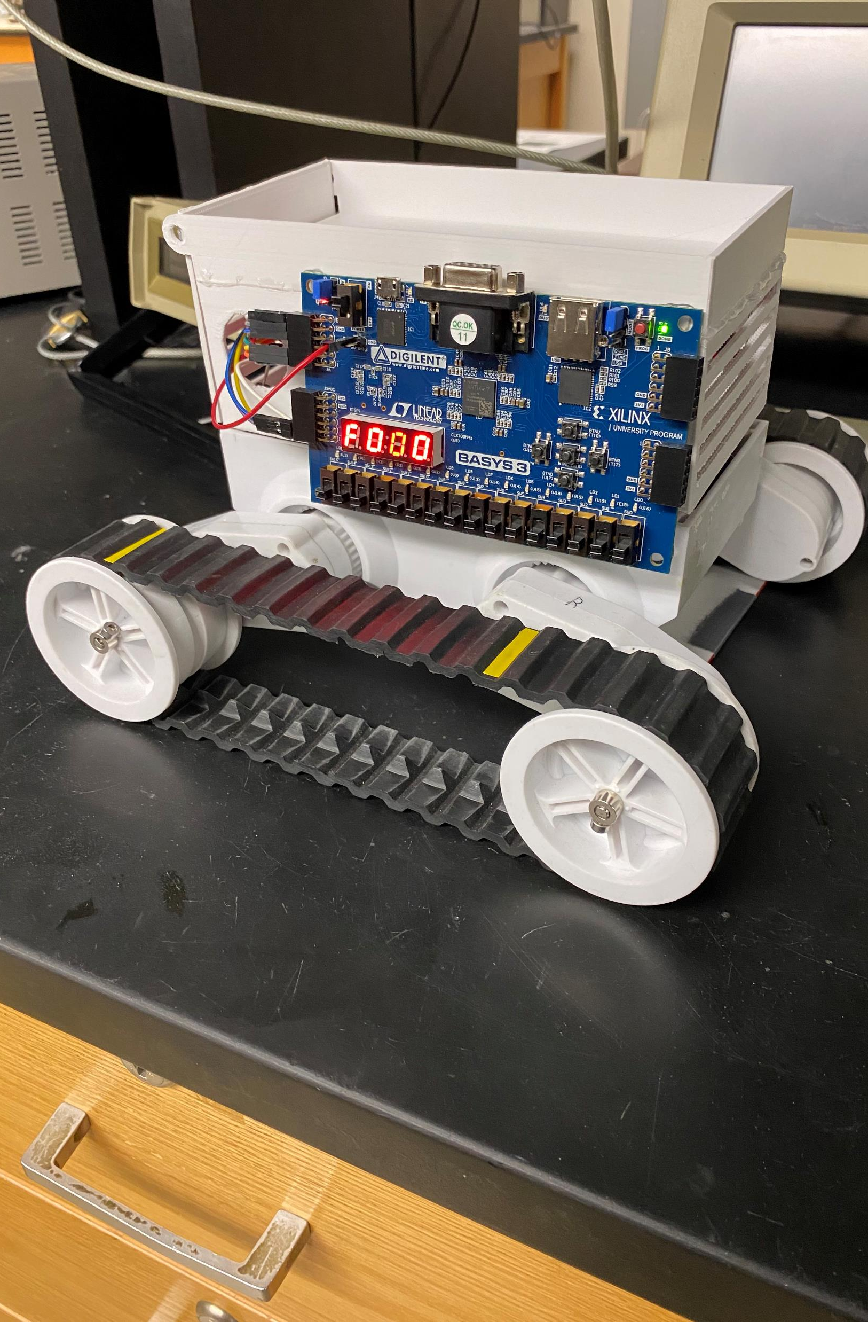
The Project Description & Objectives
Using a BASYS board, H bridge board and sensors to make a rover move along a metallic path and identify friendlies and hostiles along its path while also shooting the enemies by firing rubber bands at them

Slide 3
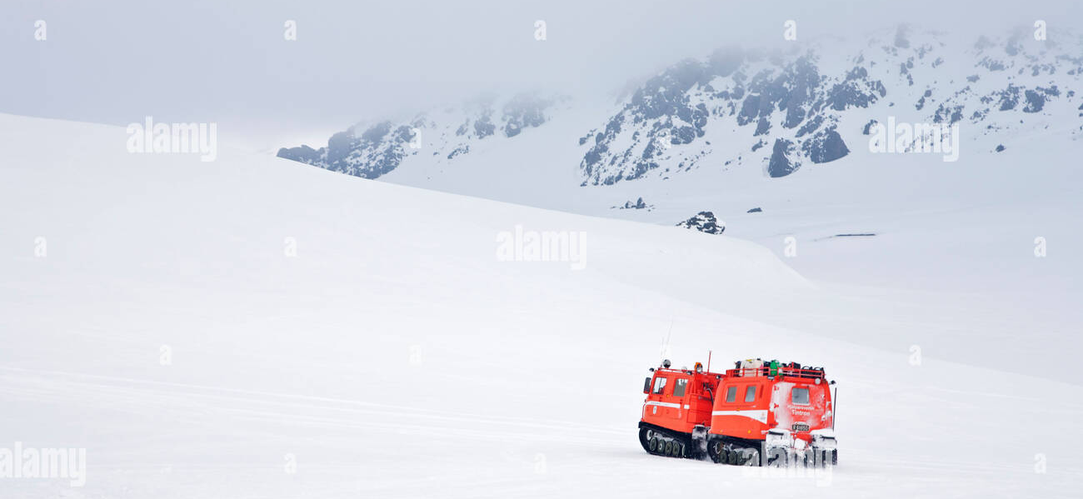
Project Opportunity
Search & Rescue: The rover could be modified to help in search and rescue operations by following a certain path in difficult terrains like snow. It will find people who in danger by making them flash a red light and detecting that with the help of enhanced phototransistors. The gun on top could be replaced with a pointer that points towards the direction of the person in need of help.

Slide 4
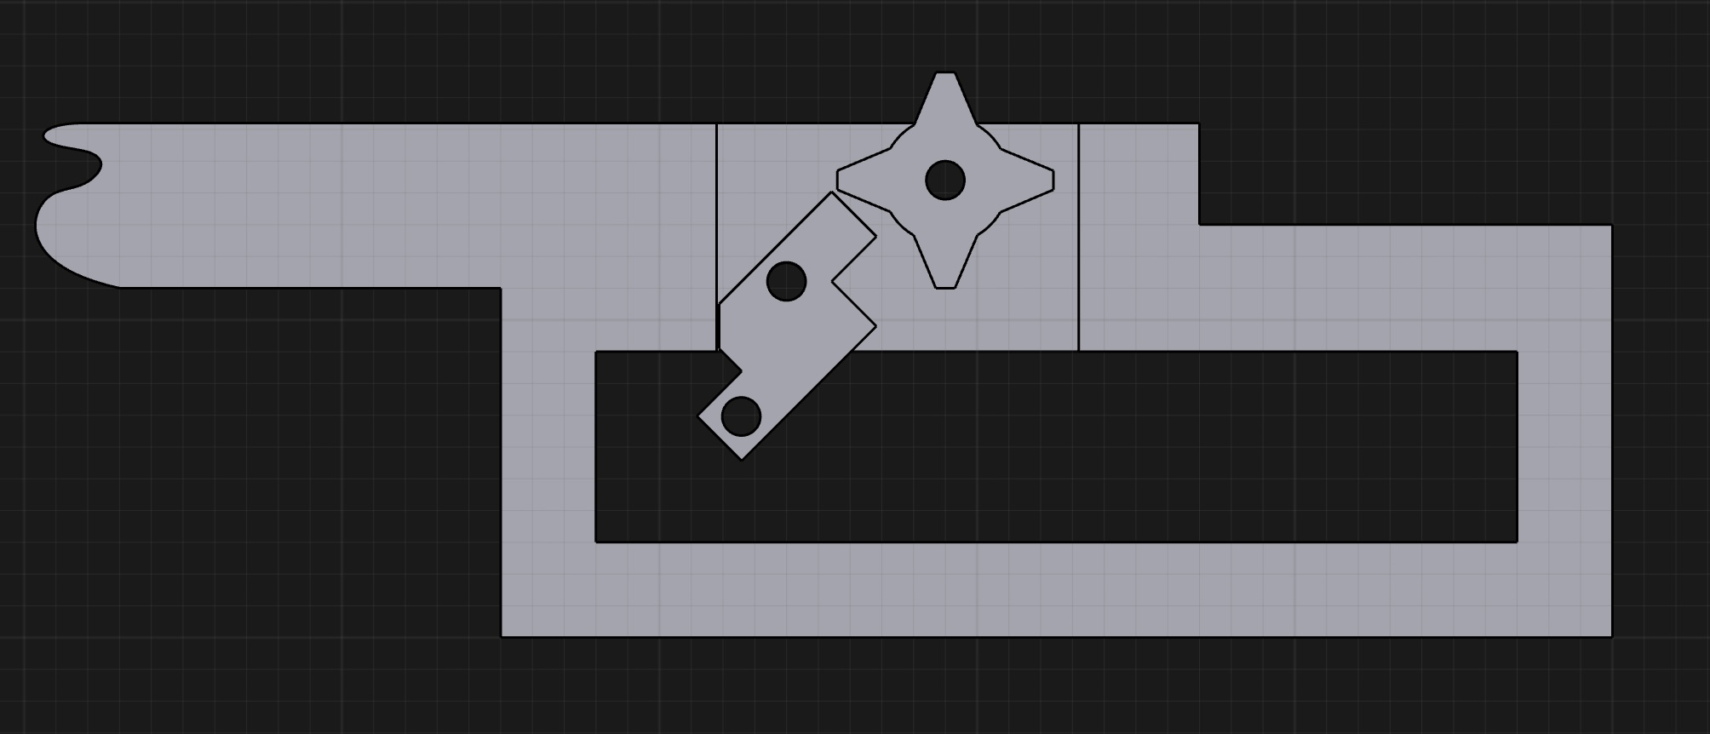
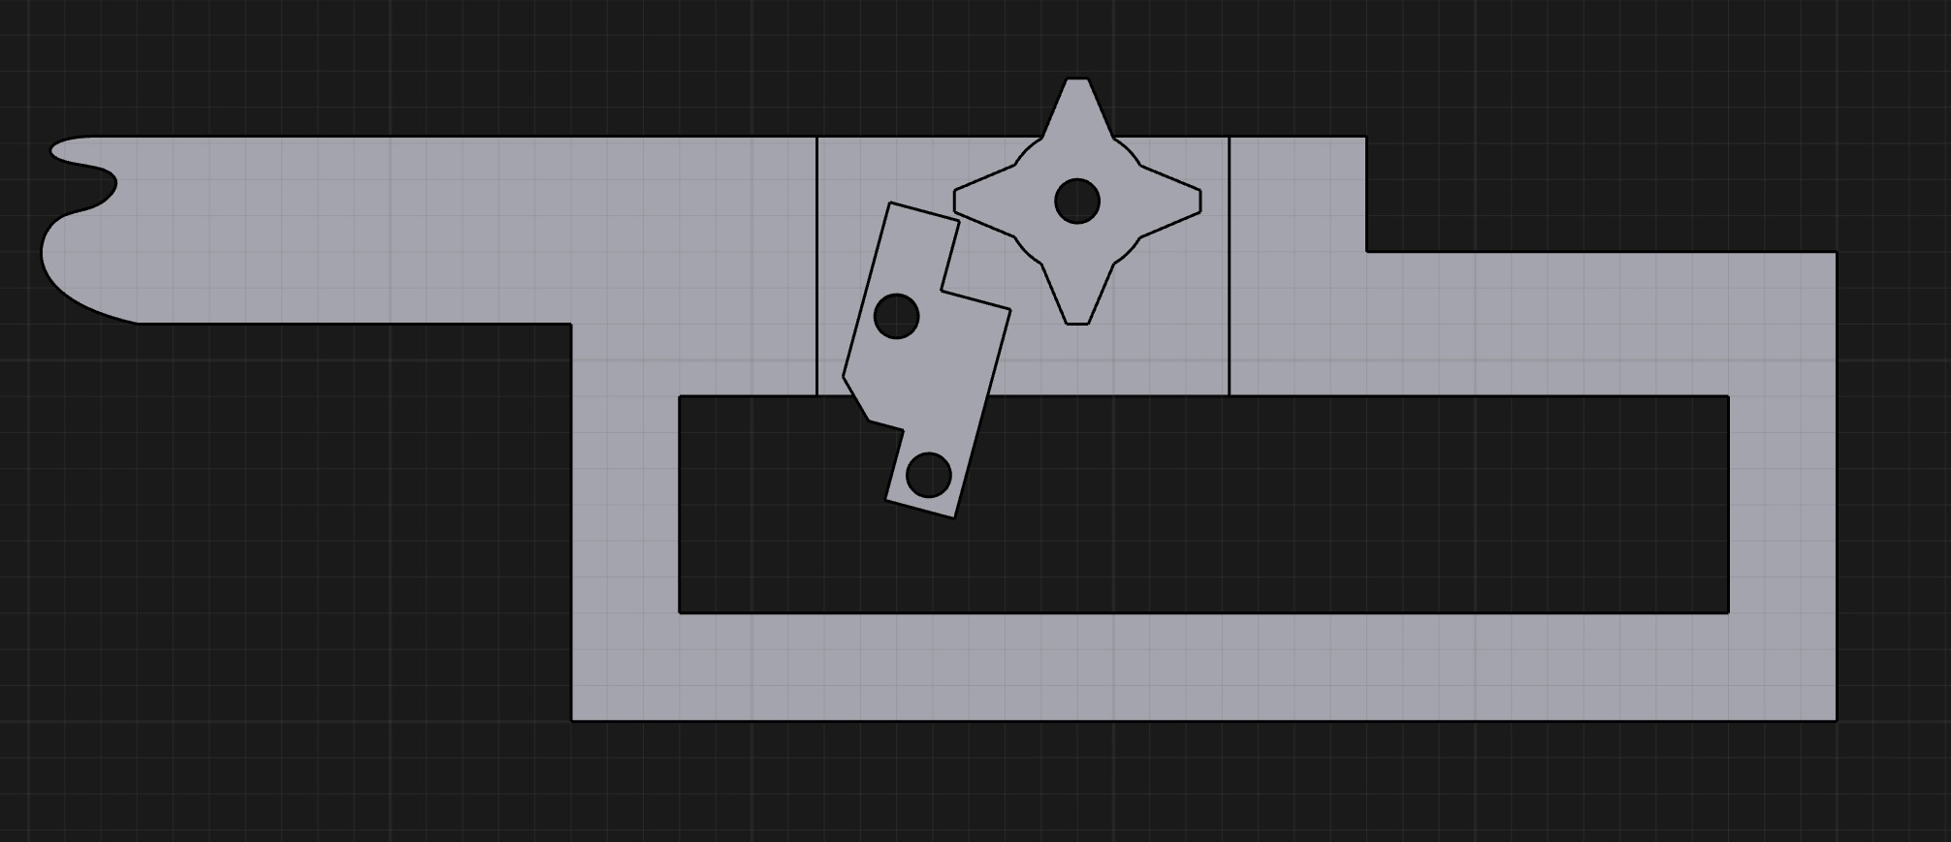
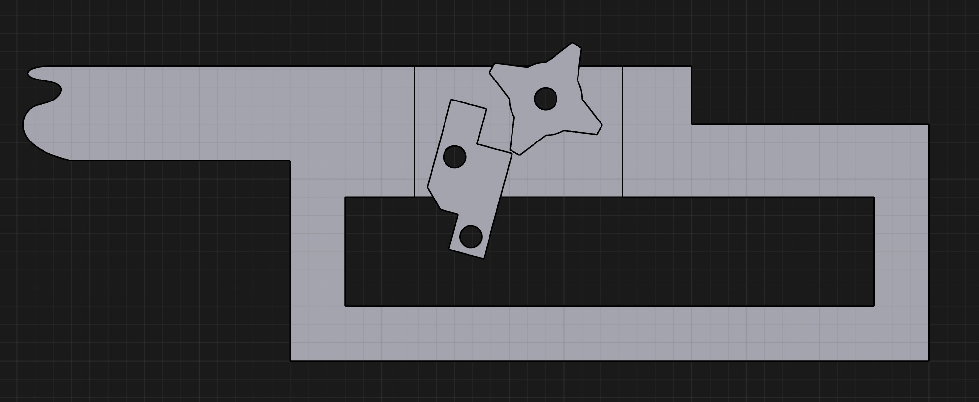
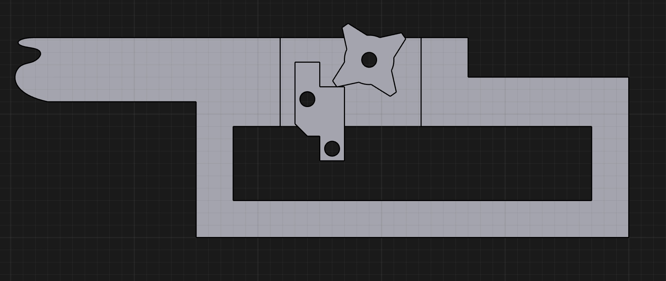
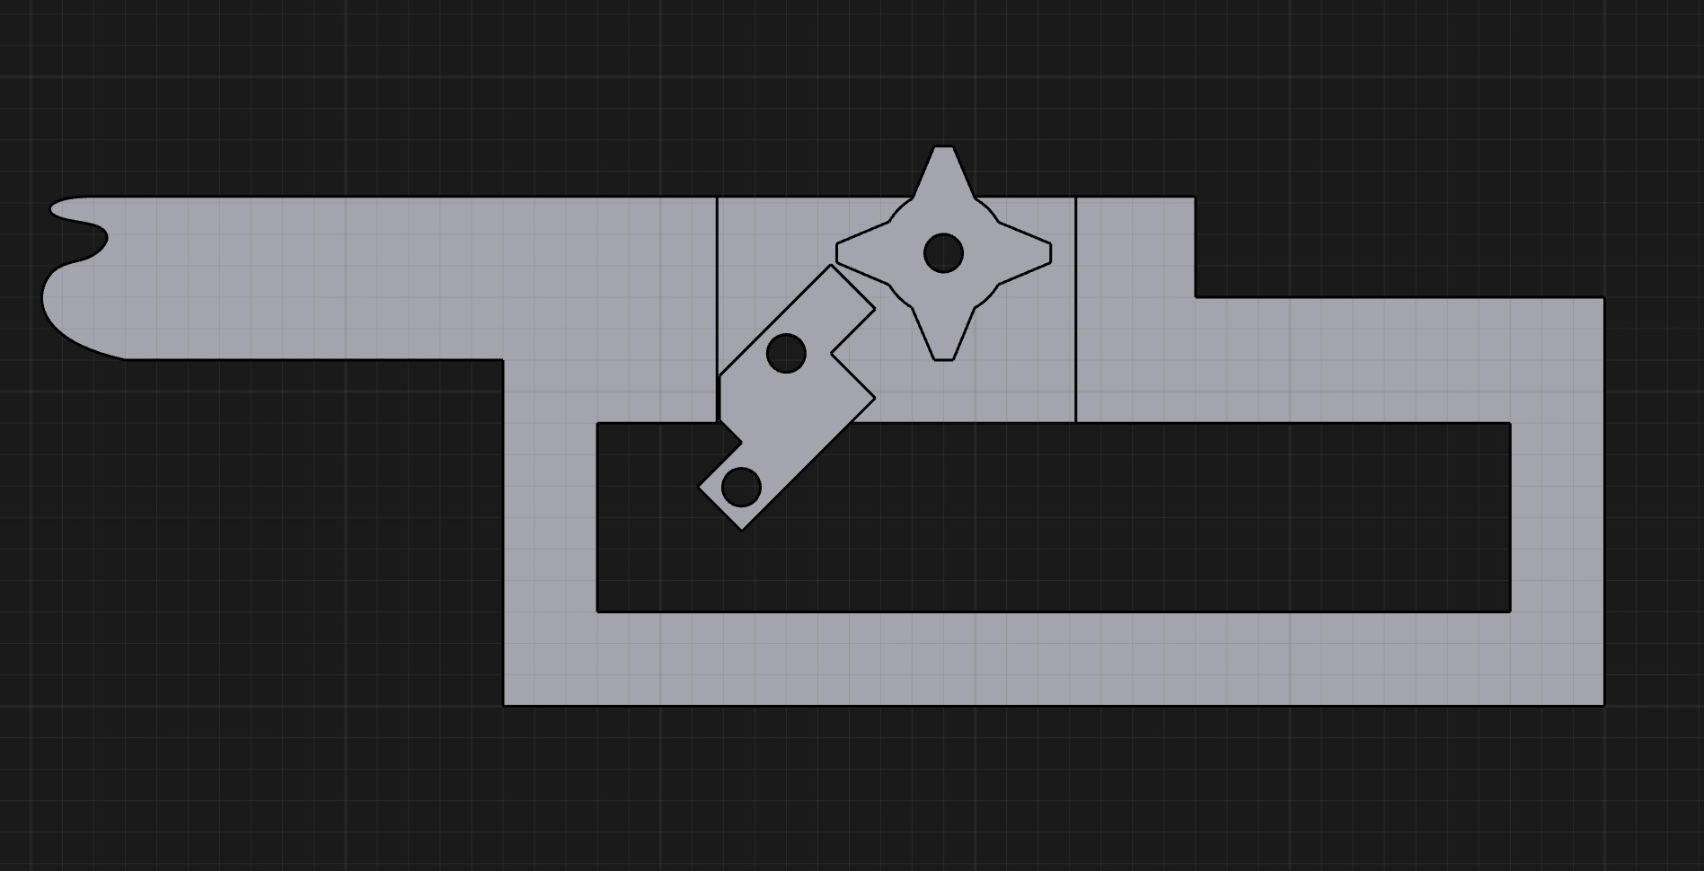
Project Sketch
3D Models for the rubber band gun

Slide 5
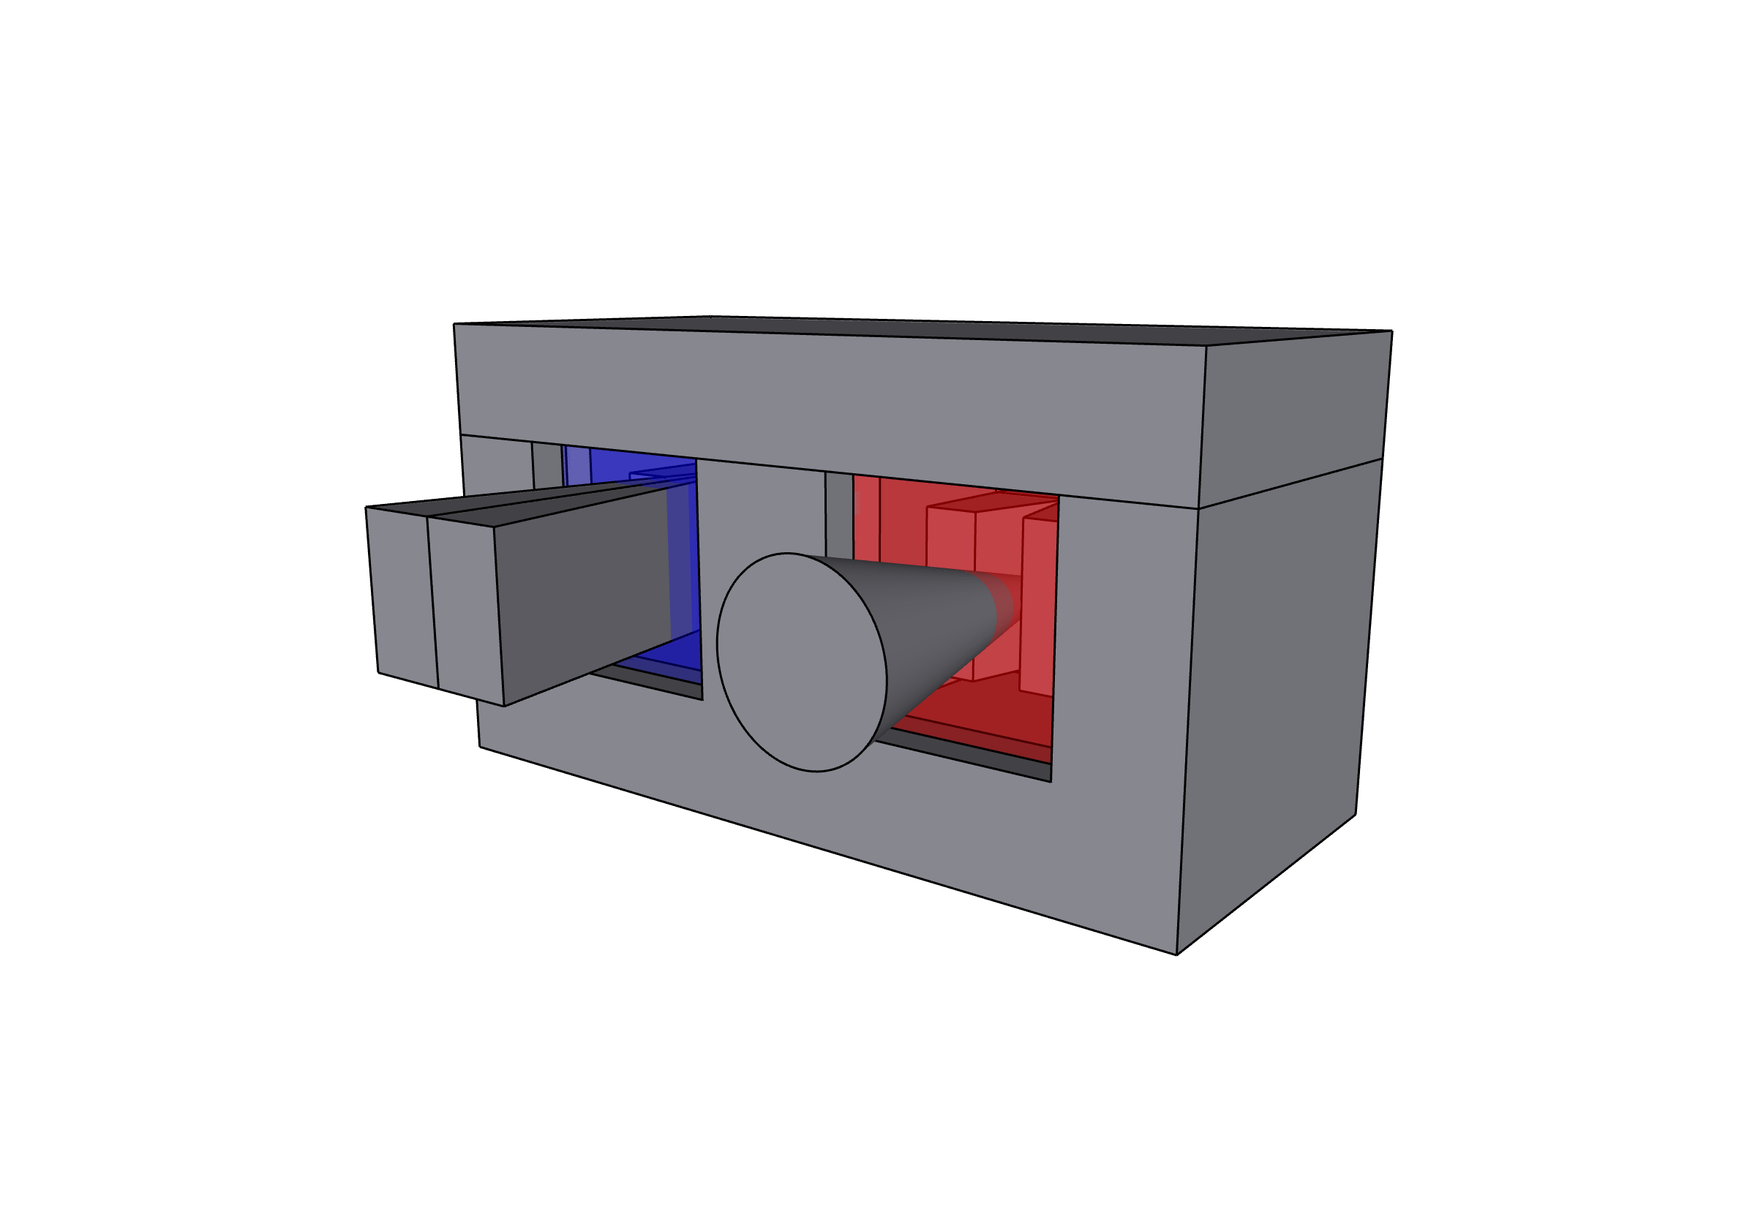
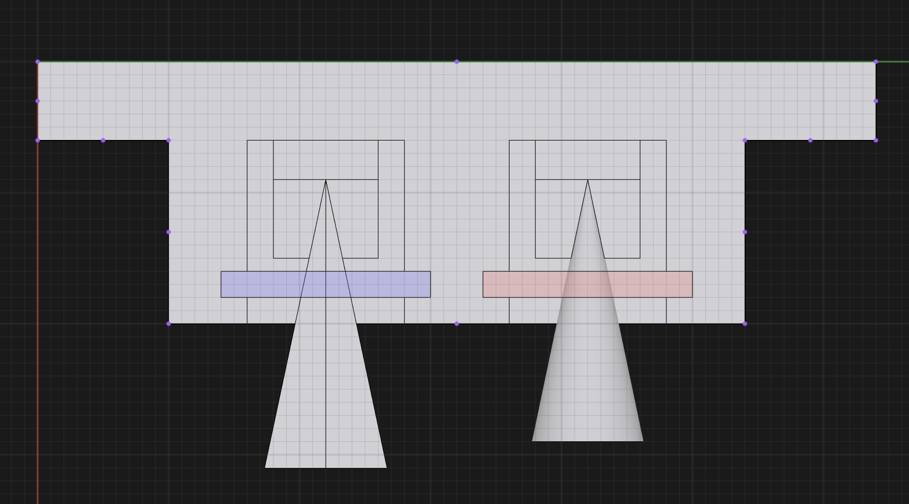
Project Sketch
Phototransistor holders

Slide 6
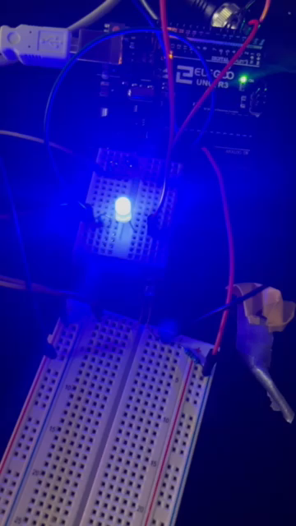
Color Filter Testing

Slide 7
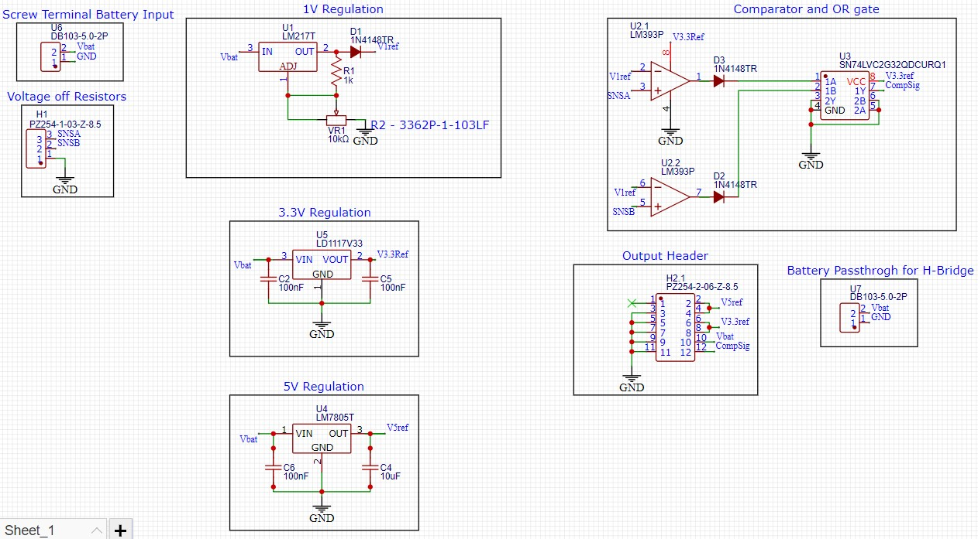
Hardware
Schematic

Slide 8
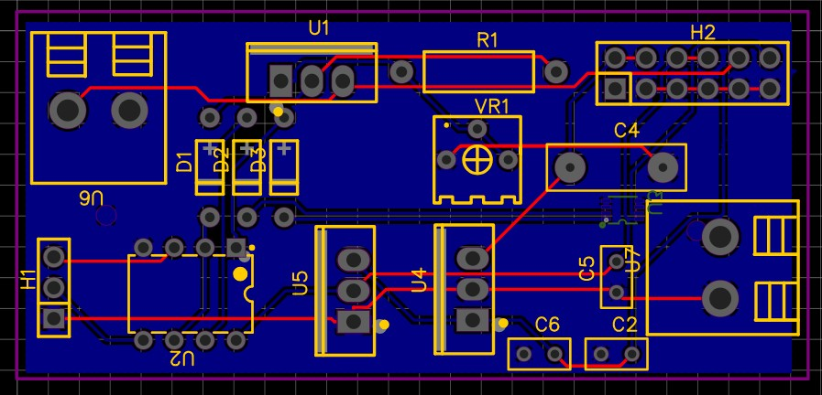
Hardware
PCB Design

Slide 9
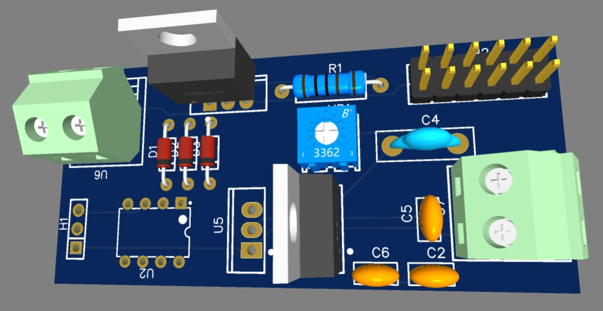
Hardware
3D Model
To do, want to make space for heatsinks for each transistor, then add two M3 mounting holes or something smaller

Slide 10
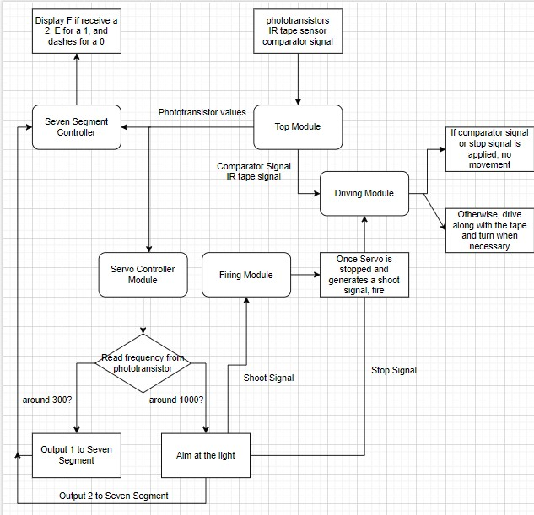
Software
Flow Chart

Slide 11
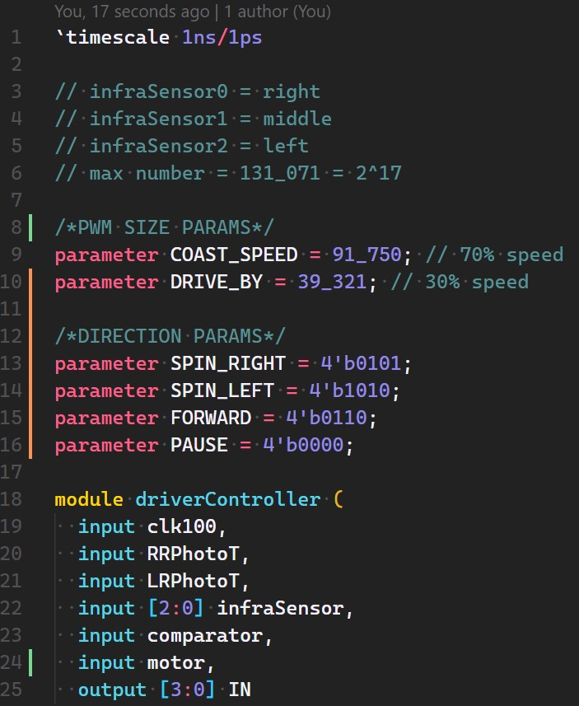
Software
Motor Controller - Initialization

Slide 12
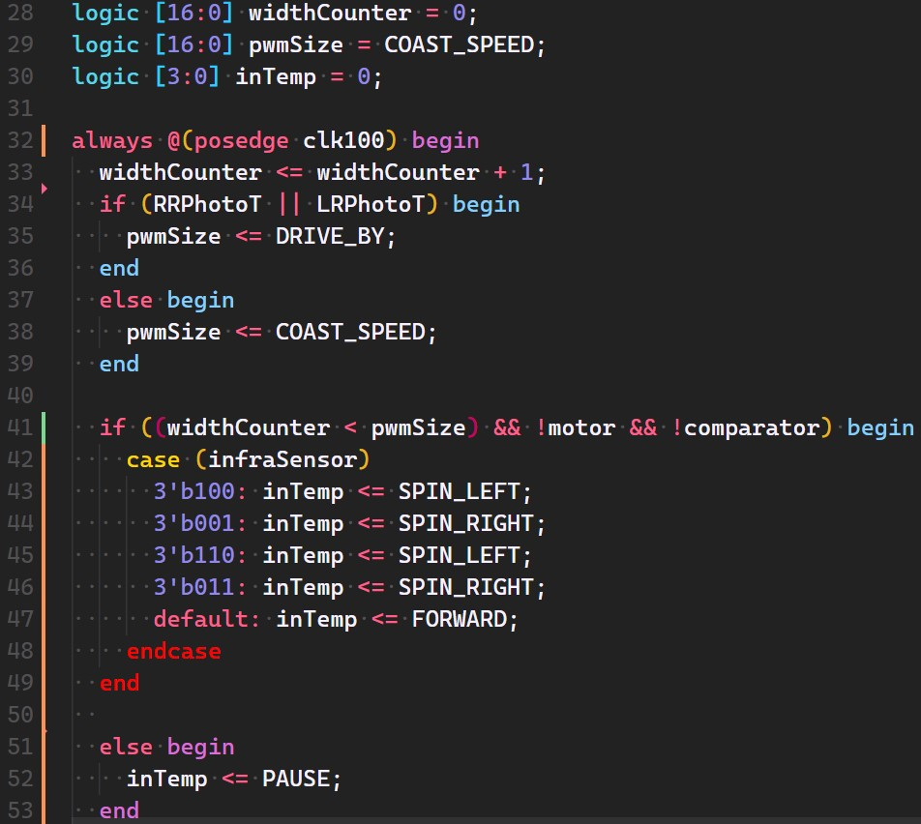
Software
Motor Controller - Logic

Slide 13
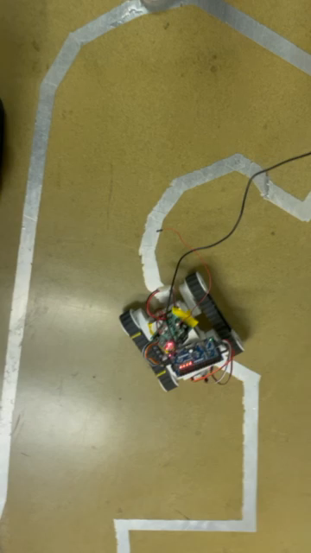
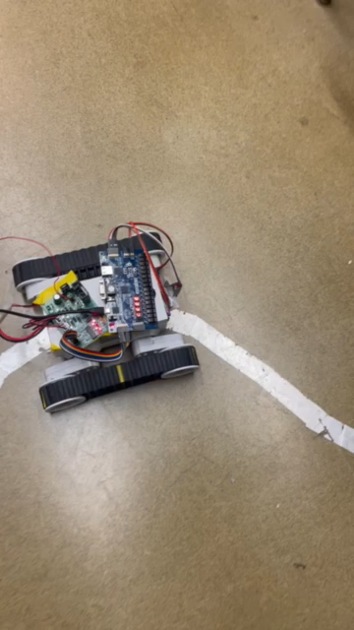
Software
Pathing Module

Slide 14
Gantt Chart

Slide 15
Overall Budget

Slide 16
Labor Hours and Material costs

Slide 17

Questions
Software Manager: Dirk Thieme
Hardware Manager: Erik Manis
Project Controller: Mohammed Ansari
This Photo by Unknown author is licensed under CC BY.

